Slide 1

Survey on NLP Techniques for Fake News Detection
Team B: Yang Lu, Junyuan Quan, Haijiao Tao, Mingwei Zhu

Slide 2

Introduction and Motivation
Introduction
Fake news threatens social trust, security, and mental health, making its detection more critical than ever. Our project use NLP to refine existing methods and develop innovative solutions for identifying misinformation on socially significant topics.
Motivation
By applying NLP techniques like Transformer and BERT, this project aims to reduce misinformation, enhance public trust, and promote social harmony while driving innovation in fake news detection.

Slide 3
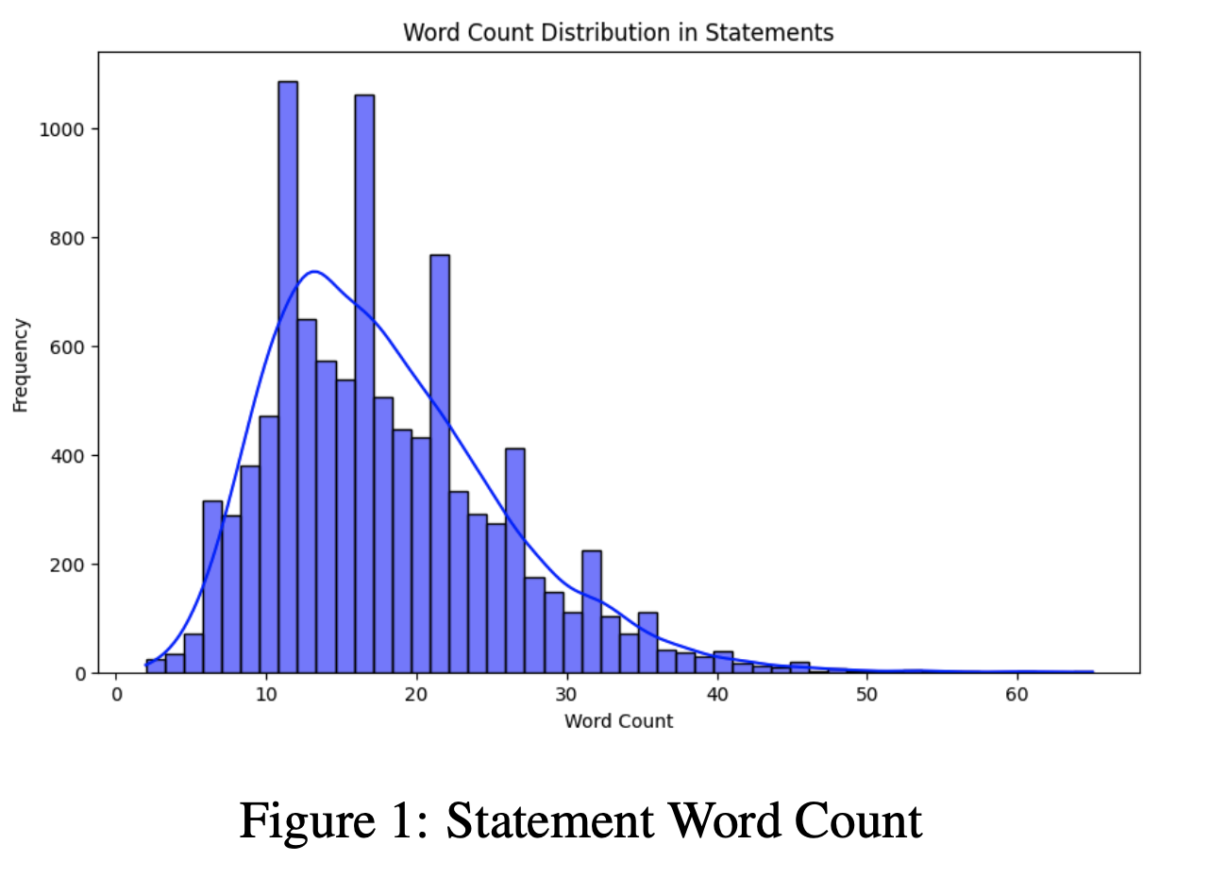
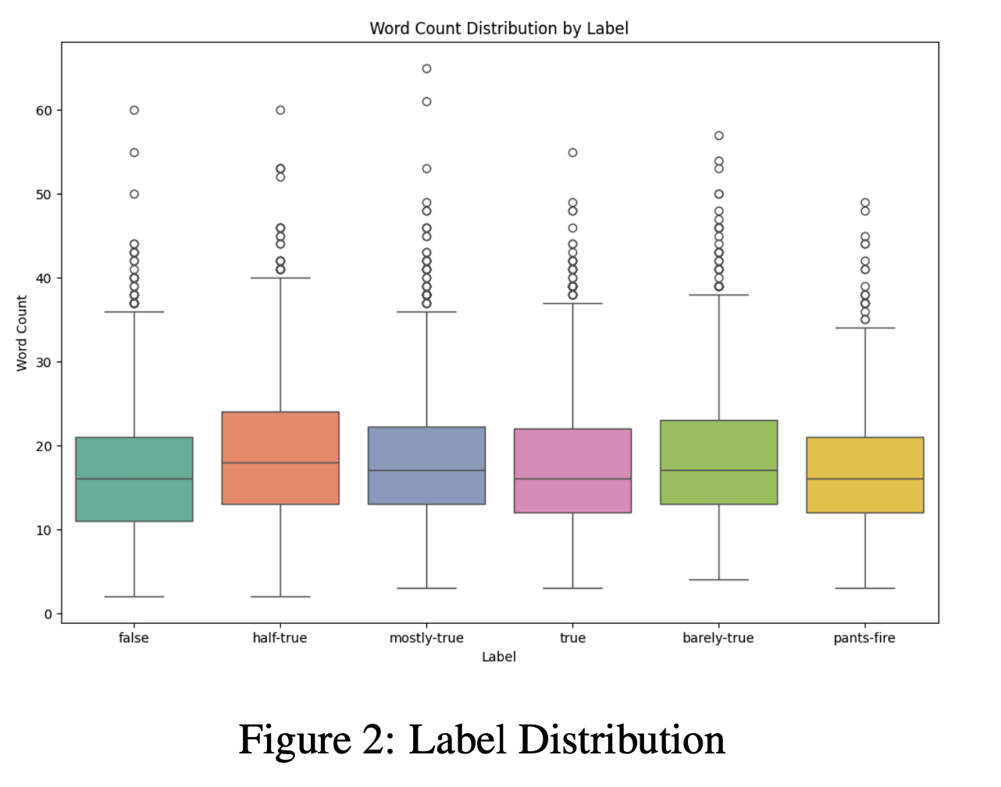
Methodology
Dataset (LIAR - Fake News)
More than 10,240 labeled articals
Feature Engineering
True ← True, Mostly-True, Half-True
False ← False, Barely-False, Pants-Fire
Model
Preprocessing
NBOW
Decoder-Only Transformer
BERT

Slide 4
Experiments and Results
Model | Accuracy
Logistic | 27% → 64%
SVM | 26% → 62%
Naive Bayes | 27% → 56%
BERT | 22% → 56%
Decoder-Only Transformer | 21% → 65%

Slide 5
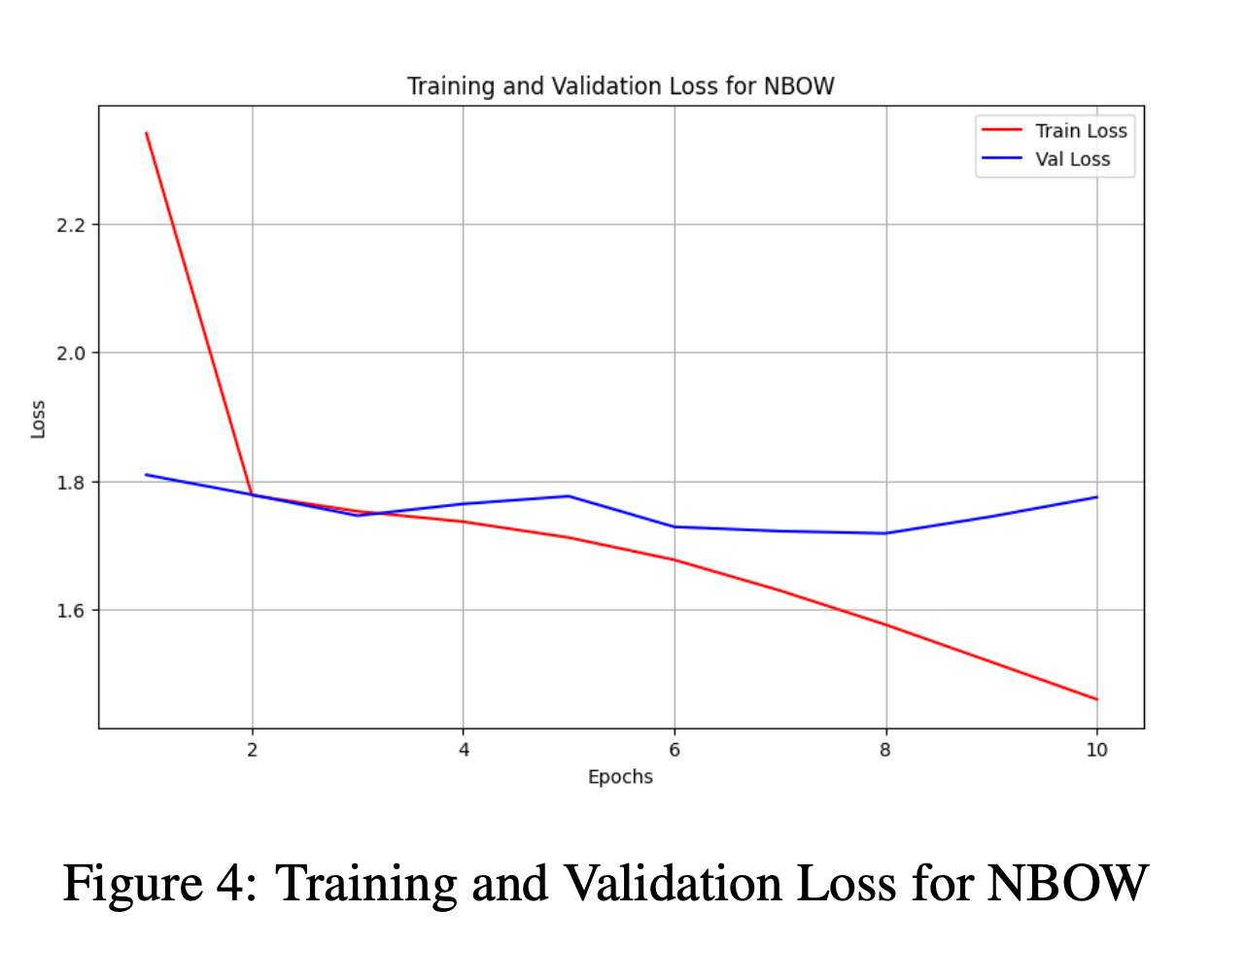
Conclusion and Limitations
What we found
Average-level accuracy overall
Transformer does not give a big advantage over simpler models
Why?
Short paragraphs, limited contexts
Simple indicative lexical cues already picked up by NBOW
Next Step
Hyperparameter tunning
Regularization to avoid overfitting (gap between training loss and validation loss)

Slide 6
Thank You

